Slide 1
Fine-Grained Location Extraction from Tweets with Temporal Awareness
Date:2015/03/19
Author:Chenliang Li, Aixin Sun
Source:SIGIR '14
Advisor:Jia-ling Koh
Spearker:LIN,CI-JIE

Slide 2
Outline
Introduction
Method
Experiment
Conclusion

Slide 3
Outline
Introduction
Method
Experiment
Conclusion

Slide 4
Introduction
Twitter is a popular platform for sharing activities, plans, and opinions.
Users often reveal their location information and short term visiting plans

Slide 5
Introduction
Goal: extract all POI(point of interest) and temporal awareness label pairs from tweet
find pairs
$$\{<L^{′}Artusi,past>,<the smile,future>\}$$

Slide 6
Challenges
Grammar errors, misspellings, informal abbreviations
POI names are ambiguous
refer to
Apple’s products
McDonald’s chain restaurant
mac

Slide 7
Outline
Introduction
Method
Experiment
Conclusion

Slide 8
Overview of PETAR

Slide 9
POI Inventory Construction
extracting the POI names mentioned in tweets that are associated with Foursquare check-ins
Regular expression

Slide 10
POI Inventory Construction
partial POI names are extracted by taking all the sub-sequences of the names (up to 5 words)
stopwords are ignored and used as separators
filtering is conducted to remove infrequent candidate POI names

Slide 11
POI Inventory Construction
Not all candidate POI names are valid
noisy data is included as well: “my room”, “my work place”, “my bed”

Slide 12
Data Analysis and Observations
Data Sets
4.33M tweets from 19,256 unique Singapore-based users during June 2010
222,201 tweets mentions at least one candidate POI name by 13,758 unique users
Observation 1:
Many users reveal their fine-grained locations in their tweets.
222,201 tweets were published by 71.4% of all users in the dataset
91.3% of the users who had published at least 20 tweets

Slide 13
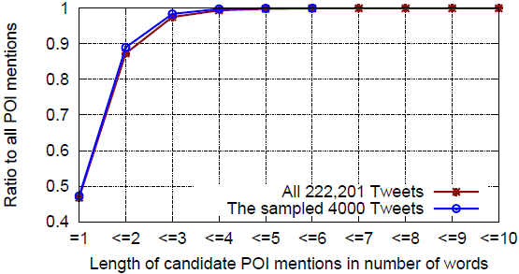
Data Analysis and Observations
Observation 2:
The candidate POI mentions are mostly very short with one or two words.
Many of the mentions are partial location names.
46.7% of the candidate POI names are unigrams
41.6%+ of the candidate POI names are partial POI names
POI names with 3 or more words are about 2.5% only.

Slide 14
Data Analysis and Observations
Observation 3:
About half of the candidate POI mentions indeed refer to locations and their associated temporal awareness can be determined.
4000 tweets are sampled from these 222,201 tweets for manual annotation

Slide 15
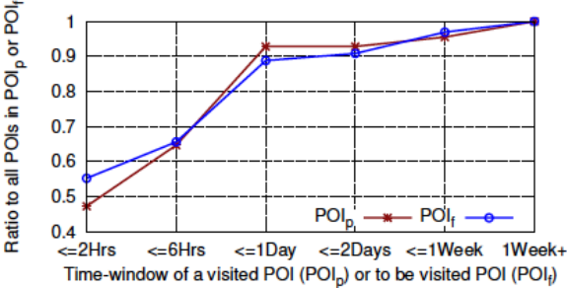
Data Analysis and Observations
Observation 4:
Among all POIs that were visited, or to be visited, about 90% of the visits to these POIs happen within a day.
Temporal awareness of POIs in ${POI}_{p}$ and ${POI}_{f}$ (854 POIs)
heading to gucci at paragon now!
We infer that the user is going to visit “paragon” within 2 hours

Slide 16
Overview of PETAR

Slide 17
Time-Aware POI Tagger
Prediction of whether a candidate POI mention is truly a POI and its temporal awareness largely relies on the context expressed in the tweet

Slide 18
Time-Aware POI Tagger
Lexical Feature
Basic lexical features of a word
the word $w_{i}$ itself and its lowercased form $x_{i}$
the word shape of $w_{i}$ : all-capitalized, is-capitalized, all-numerics, alphanumeric
the prefixes and suffixes of $x_{i}$ , from 1 to 3 characters
the prior probabilities of $x_{i}$ being in capitalization and in all-capitalization forms respectively.

Slide 19
Time-Aware POI Tagger
Lexical Feature
Contextual features of a word
bag-of-words of the context window up to 5 words: $x_{i−2}$, $x_{i−1}$, $x_{i}$ , $x_{i+1}$, $x_{i+2}$
bag-of-words of the preceding two words $:x_{i−2}$, $x_{i−1}$
bag-of-words of the preceding two words: $x_{i+1}$,$x_{i+2}$

Slide 20
Time-Aware POI Tagger
The dog runs.
A dog jumps.
The dog jumps.
A cat runs.
The cat jumps.
Grammatical Feature
Part-of-speech (POS) tag
Consider the POS tags of the current word $w_{i}$and its surrounding two words $w_{i−1}$and $w_{i+1}$
Word group by Brown clustering
Brown clustering is an algorithm that groups words that appear in similar contexts in a hierarchy
we use the 4th, 8th and 12th bits of its path to abstract its lexical variations,resulting in three features

Slide 21
Time-Aware POI Tagger
Grammatical Feature
Time-trend score of tweet
The dictionary D contains 36 commonly used words in English with manually assigned time-trend scores: 1, 0, and -1
Verbs tagged with VBN and VBD are assigned score -1; VBZ, VBP, VBG and VB assigned with score 0
compute a time-trend score for a tweet t and then take the average of the scores assigned
yesterday
-1
-1

Slide 22
Time-Aware POI Tagger
Grammatical Feature
The closest verb
The closest verb to a candidate location name based on TwitterNLP POS tagging
The tense label of the verb
The distance of the verb to candidate location name, and whether the verb is to the left of candidate location name.
closet Verb | tense | distance | left
went | past | 10000000000 | True

Slide 23
Time-Aware POI Tagger
Geographical Feature
Spatial randomness
divide the map of Singapore into lattices(1KM*1KM) S
Let $k_{l}$ be the total number of check-in tweets location l
$k_{l,s}$ be the number of check-in tweets that mention l and fall in lattice s

Slide 24
Time-Aware POI Tagger
Geographical Feature
Location name confidence
Let $μ_{i}$ and $σ_{i}$be the average and the standard deviation of all $k_{l}$‘s of length I
Multiple candidate POI mention
binary feature is added to indicate whether a given tweet mentions multiple candidate POI names

Slide 25
Time-Aware POI Tagger
BILOU Schema Feature
because of the POI inventory, the candidate POI mentions in a tweet can be pre-labeled with BILOU schema

Slide 26
Overview of PETAR

Slide 27
Outline
Introduction
Method
Experiment
Conclusion

Slide 28
Experiment
Experiment Setup
manually annotated 4000 tweets as ground truth
5-fold cross validation is applied
Evaluation metrics: Precision, Recall and F1
Comparative Methods
Random Annotation (RA)
K-Nearest Neighbor (KNN)
StanfordNER (CRF-Classifier)

Slide 29
Experiment
POI extraction with temporal awareness
Disambiguating POIs (ignoring temporal awareness)

Slide 30
Experiment
Lexical features are better for POI mention disambiguation
Grammatical features are better for resolving temporal awareness

Slide 31
Experiment
Lexical + Grammatical features are better in most cases

Slide 32
Outline
Introduction
Method
Experiment
Conclusion

Slide 33
Conclusion
facilitate the fine-grained location-based services/marketing and personalization
PETAR exploits the crowd wisdom of Foursquare community to enable fine-grained location extraction
time-aware POI tagger conducts the location extraction and temporal awareness resolution in an effective and efficient way

Slide 34
Thanks for listening.

